Slide 1
Relations
Chapter 9
© 2019 McGraw-Hill Education. All rights reserved. Authorized only for instructor use in the classroom. No reproduction or further distribution permitted without the prior written consent of McGraw-Hill Education.

Slide 2
Chapter Summary
Relations and Their Properties
n-ary Relations and Their Applications (not currently included in overheads)
Representing Relations
Closures of Relations (not currently included in overheads)
Equivalence Relations
Partial Orderings

Slide 3
Relations and Their Properties
Section 9.1

Slide 4
Section Summary
Relations and Functions
Properties of Relations
Reflexive Relations
Symmetric and Antisymmetric Relations
Transitive Relations
Combining Relations

Slide 5
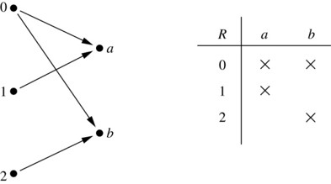
Binary Relations
Definition: A binary relation R from a set A to a set B is a subset
Example:
Let A = {0,1,2} and B = {a,b}
{(0, a), (0, b), (1,a) , (2, b)} is a relation from A to B.
We can represent relations from a set A to a set B graphically or using a table:
Relations are more general than functions. A function is a relation where exactly one element of B is related to each element of A.
Jump to long description

Slide 6
Binary Relations on a Set 1
Definition: A binary relation R on a set A is a subset of A × A or a relation from A to A.
Example:
Suppose that A = {a,b,c}. Then R = {(a,a),(a,b), (a,c)} is a relation on A.
Let A = {1, 2, 3, 4}. The ordered pairs in the relation R = {(a,b) | a divides b} are (1,1), (1, 2), (1,3), (1, 4), (2, 2), (2, 4), (3, 3), and (4, 4).

Slide 7
Binary Relations on a Set 2
Question: How many relations are there on a set A?
Solution: Because a relation on A is the same thing as a subset of A × A, we count the subsets of A × A. Since A × A has n² elements when A has n elements, and a set with m elements has 2^{m} subsets, there are subsets of A × A. Therefore, there are relations on a set A.

Slide 8
Binary Relations on a Set 3
Example: Consider these relations on the set of integers:
Note that these relations are on an infinite set and each of these relations is an infinite set.
Which of these relations contain each of the pairs
(1,1), (1, 2), (2, 1), (1, −1), and (2, 2)?
Solution: Checking the conditions that define each relation, we see that the pair (1,1) is in R₁, R₃, R₄ , and R₆: (1,2) is in R₁ and R₆: (2,1) is in R₂, R₅, and R₆: (1, −1) is in R₂, R₃, and R₆ : (2,2) is in R₁, R₃, and R₄.

Slide 9
Reflexive Relations
Definition: R is reflexive iff (a,a) ∊ R for every element a ∊ A. Written symbolically, R is reflexive if and only if
Example: The following relations on the integers are reflexive:
If A = ∅ then the empty relation is reflexive vacuously. That is the empty relation on an empty set is reflexive!

Slide 10
Symmetric Relations
Definition: R is symmetric iff (b,a) ∊ R whenever (a,b) ∊ R for all a,b ∊ A. Written symbolically, R is symmetric if and only if
Example: The following relations on the integers are symmetric:

Slide 11
Antisymmetric Relations
Definition: A relation R on a set A such that for all a,b ∊ A if (a,b) ∊ R and (b,a) ∊ R, then a = b is called antisymmetric. Written symbolically, R is antisymmetric if and only if
Example: The following relations on the integers are antisymmetric:
For any integer, if a a ≤ b and b ≤ a , then a = b.

Slide 12
Transitive Relations
Definition: A relation R on a set A is called transitive if whenever (a,b) ∊ R and (b,c) ∊ R, then (a,c) ∊ R, for all a,b,c ∊ A. Written symbolically, R is transitive if and only if
Example: The following relations on the integers are transitive:
For every integer, a ≤ b and b ≤ c, then b ≤ c.

Slide 13
Combining Relations
Given two relations R₁ and R₂, we can combine them using basic set operations to form new relations such as R₁ ∪ R₂, R₁ ∩ R₂, R₁ − R₂, and R₂ − R₁.
Example: Let A = {1,2,3} and B = {1,2,3,4}. The relations R₁ = {(1,1),(2,2),(3,3)} and R₂ = {(1,1),(1,2),(1,3),(1,4)} can be combined using basic set operations to form new relations:

Slide 14
Composition
Definition: Suppose
R₁ is a relation from a set A to a set B.
R₂ is a relation from B to a set C.
Then the composition (or composite) of R₂ with R₁, is a relation from A to C where
if (x,y) is a member of R₁ and (y,z) is a member of R₂, then (x,z) is a member of R₂∘ R₁.

Slide 15
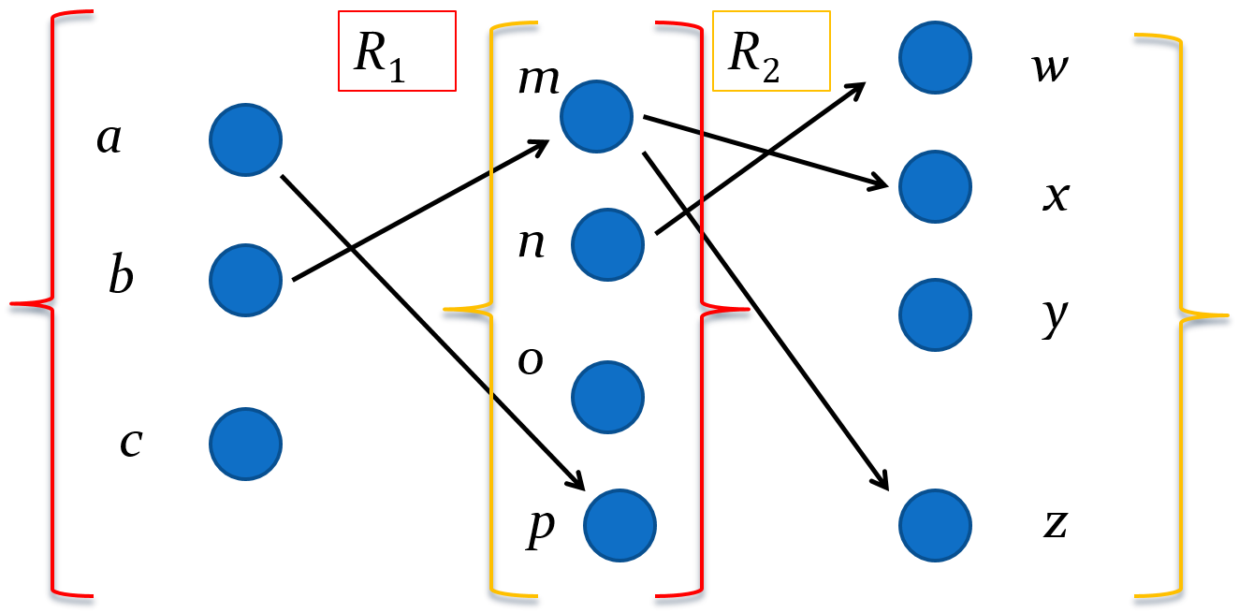
Representing the Composition of Relations

Slide 16
Powers of a Relation
Definition: Let R be a binary relation on A. Then the powers R^{n} of the relation R can be defined inductively by:
Basis Step: R¹ = R
Inductive Step: R^{n+1} = R^{n} ∘ R
(see the slides for Section 9.3 for further insights)
The powers of a transitive relation are subsets of the relation. This is established by the following theorem:
Theorem 1: The relation R on a set A is transitive iff R^{n} ⊆ R for n = 1,2,3 ….
(see the text for a proof via mathematical induction)

Slide 17
Representing Relations
Section 9.3

Slide 18
Section Summary
Representing Relations using Matrices
Representing Relations using Digraphs

Slide 19
Representing Relations Using Matrices
A relation between finite sets can be represented using a zero-one matrix.
Suppose R is a relation from A = {a₁, a₂, …, a_{m}} to B = {b₁, b₂, …, b_{n}}.
The elements of the two sets can be listed in any particular arbitrary order. When A = B, we use the same ordering.
The relation R is represented by the matrix M_{R} = [m_{ij}], where
The matrix representing R has a 1 as its (i,j) entry when a_{i} is related to b_{j} and a 0 if a_{i} is not related to b_{j}.

Slide 20
Examples of Representing Relations Using Matrices 1
Example 1: Suppose that A = {1,2,3} and B = {1,2}. Let R be the relation from A to B containing (a,b) if a ∈ A, b ∈ B, and a > b. What is the matrix representing R (assuming the ordering of elements is the same as the increasing numerical order)?
Solution: Because R = {(2,1), (3,1),(3,2)}, the matrix is

Slide 21
Examples of Representing Relations Using Matrices 2
Example 2: Let A = {a₁,a₂, a₃} and B = {b₁,b₂, b₃,b₄, b₅}. Which ordered pairs are in the relation R represented by the matrix
Solution: Because R consists of those ordered pairs (a_{i},b_{j}) with m_{ij} = 1, it follows that:

Slide 22
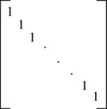
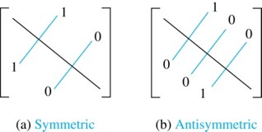
Matrices of Relations on Sets
If R is a reflexive relation, all the elements on the main diagonal of M_{R} are equal to 1.
R is a symmetric relation, if and only if m_{ij} = 1 whenever m_{ji} = 1. R is an antisymmetric relation, if and only if m_{ij} = 0 or m_{ji} = 0 when i≠ j.
Jump to long description

Slide 23
Example of a Relation on a Set
Example 3: Suppose that the relation R on a set is represented by the matrix
Is R reflexive, symmetric, and/or antisymmetric?
Solution: Because all the diagonal elements are equal to 1, R is reflexive. Because M_{R} is symmetric, R is symmetric and not antisymmetric because both m_{1,2} and m_{2,1} are 1.

Slide 24
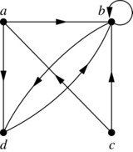
Representing Relations Using Digraphs
Definition: A directed graph, or digraph, consists of a set V of vertices (or nodes) together with a set E of ordered pairs of elements of V called edges (or arcs). The vertex a is called the initial vertex of the edge (a,b), and the vertex b is called the terminal vertex of this edge.
An edge of the form (a,a) is called a loop.
Example 7: A drawing of the directed graph with vertices a, b, c, and d, and edges (a, b), (a, d), (b, b), (b, d), (c, a), (c, b), and (d, b) is shown here.
Jump to long description

Slide 25
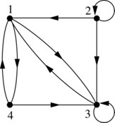
Examples of Digraphs Representing Relations
Example 8: What are the ordered pairs in the relation represented by this directed graph?
Solution: The ordered pairs in the relation are (1, 3), (1, 4), (2, 1), (2, 2), (2, 3), (3, 1), (3, 3), (4, 1), and (4, 3)
Jump to long description

Slide 26
Determining which Properties a Relation has from its Digraph
Reflexivity: A loop must be present at all vertices in the graph.
Symmetry: If (x,y) is an edge, then so is (y,x).
Antisymmetry: If (x,y) with x ≠ y is an edge, then (y,x) is not an edge.
Transitivity: If (x,y) and (y,z) are edges, then so is (x,z).

Slide 27
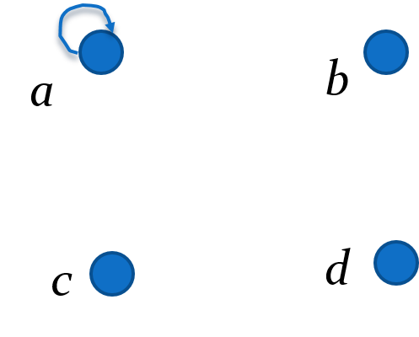
Determining which Properties a Relation has from its Digraph – Example 1
Reflexive? No, not every vertex has a loop
Symmetric? Yes (trivially), there is no edge from one vertex to another
Antisymmetric? Yes (trivially), there is no edge from one vertex to another
Transitive? Yes, (trivially) since there is no edge from one vertex to another

Slide 28
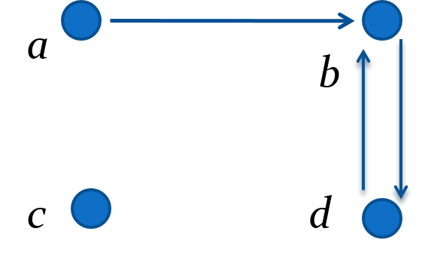
Determining which Properties a Relation has from its Digraph – Example 2
Reflexive? No, there are no loops
Symmetric? No, there is an edge from a to b, but not from b to a
Antisymmetric? No, there is an edge from d to b and b to d
Transitive? No, there are edges from a to c and from c to b, but there is no edge from a to d

Slide 29
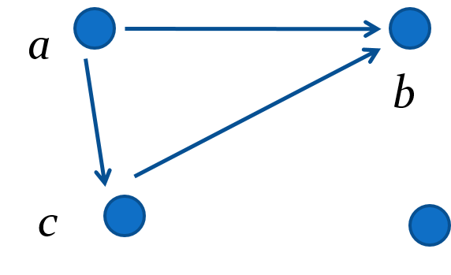
Determining which Properties a Relation has from its Digraph – Example 3
Reflexive? No, there are no loops
Symmetric? No, for example, there is no edge from c to a
Antisymmetric? Yes, whenever there is an edge from one vertex to another, there is not one going back
Transitive? Yes.

Slide 30
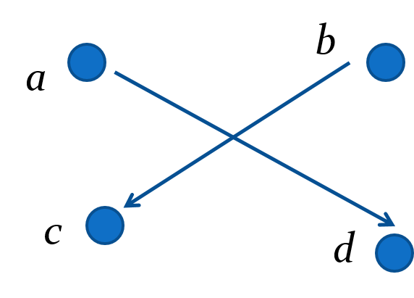
Determining which Properties a Relation has from its Digraph – Example 4
Reflexive? No, there are no loops
Symmetric? No, for example, there is no edge from d to a
Antisymmetric? Yes, whenever there is an edge from one vertex to another, there is not one going back
Transitive? Yes (trivially), there are no two edges where the first edge ends at the vertex where the second edge begins

Slide 31
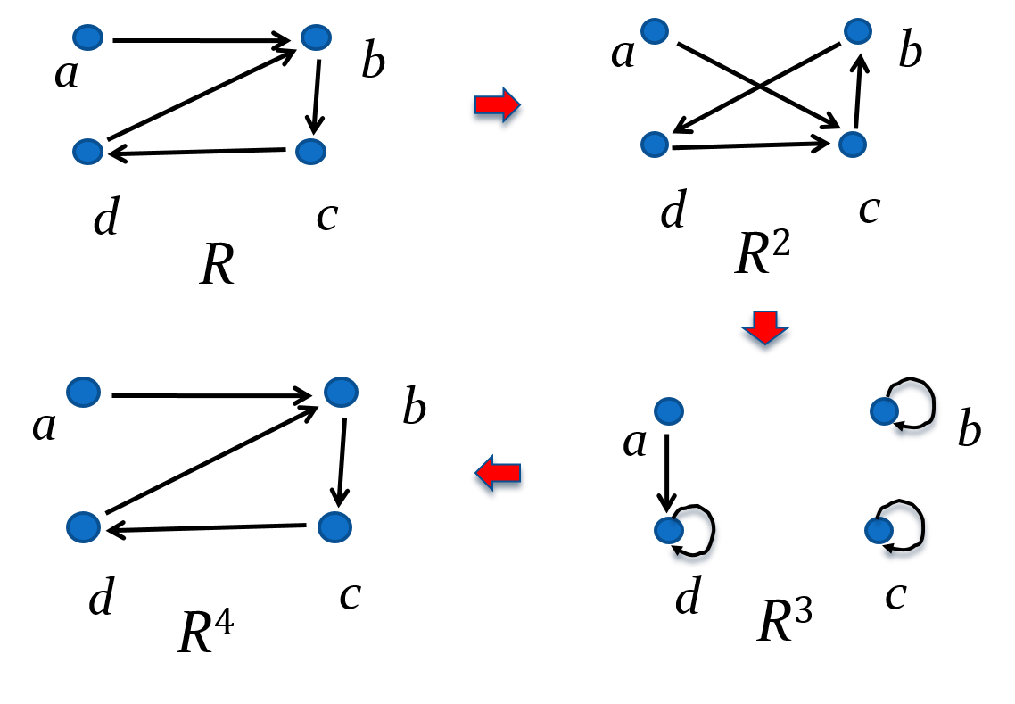
Example of the Powers of a Relation
The pair (x,y) is in R^{n} if there is a path of length n from x to y in R (following the direction of the arrows).

Slide 32
Closures of Relations
Section 9.4

Slide 33
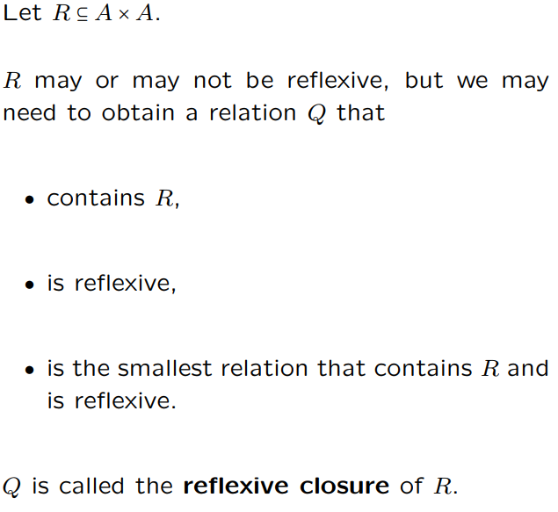
Closures of Relations

Slide 34
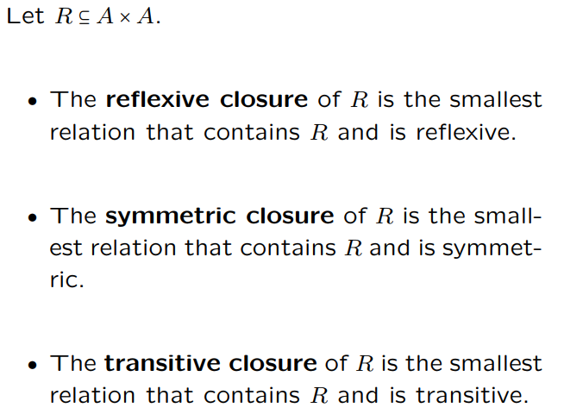
Closures of Relations

Slide 35
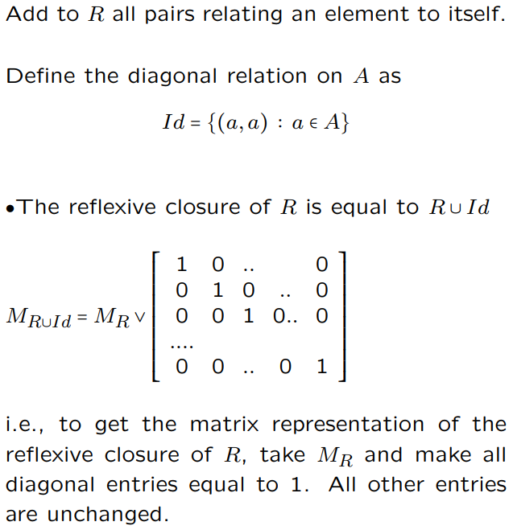
Reflexive Closure

Slide 36

Reflexive Closure example
Consider the following relation:
Is it reflexive?
What is the reflexive closure of R₂?

Slide 37
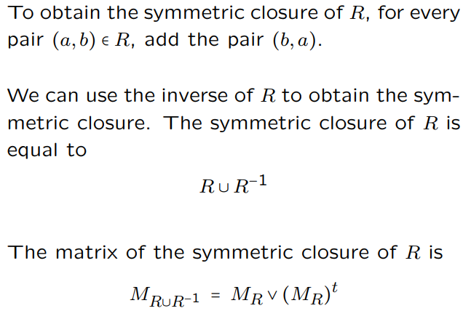
Symmetric Closure

Slide 38
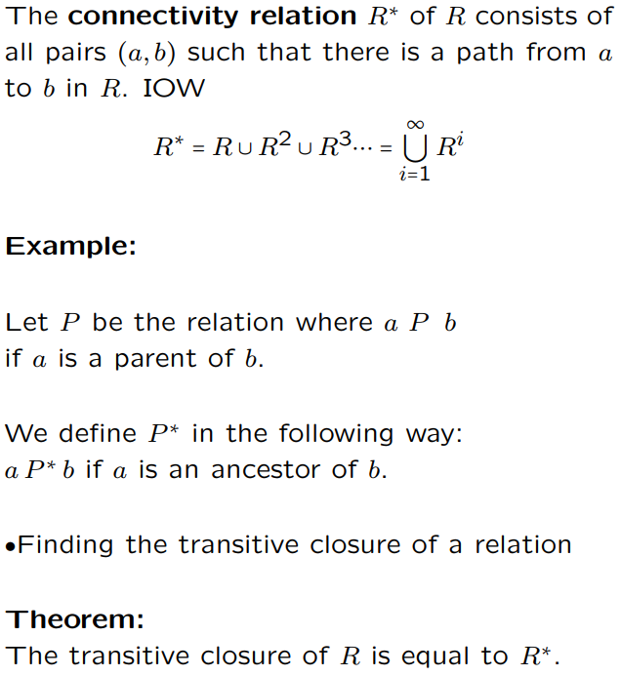
Transitive Closure

Slide 39
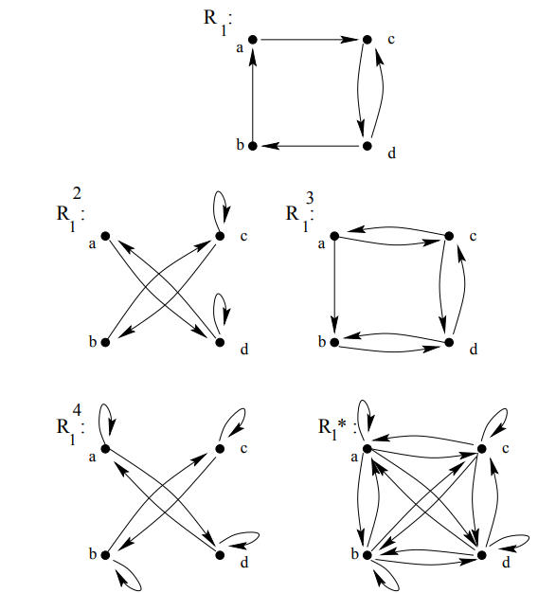
Transitive Closure

Slide 40
Equivalence Relations
Section 9.5

Slide 41
Section Summary
Equivalence Relations
Equivalence Classes
Equivalence Classes and Partitions

Slide 42
Equivalence Relations
Definition 1: A relation on a set A is called an equivalence relation if it is reflexive, symmetric, and transitive.
Definition 2: Two elements a, and b that are related by an equivalence relation are called equivalent. The notation a ∼ b is often used to denote that a and b are equivalent elements with respect to a particular equivalence relation.

Slide 43
Strings
Example: Suppose that R is the relation on the set of strings of English letters such that aRb if and only if l(a) = l(b), where l(x) is the length of the string x. Is R an equivalence relation?
Solution: Show that all of the properties of an equivalence relation hold.
Reflexivity: Because l(a) = l(a), it follows that aRa for all strings a.
Symmetry: Suppose that aRb. Since l(a) = l(b), l(b) = l(a) also holds and bRa.
Transitivity: Suppose that aRb and bRc. Since l(a) = l(b),and l(b) = l(c), l(a) = l(c) also holds and aRc.

Slide 44
Congruence Modulo m
Example: Let m be an integer with m > 1. Show that the relation R = {(a,b) | a ≡ b (mod m)} is an equivalence relation on the set of integers.
Solution: Recall that a ≡ b (mod m) if and only if m divides a − b.
Reflexivity: a ≡ a (mod m) since a − a = 0 is divisible by m since 0 = 0 ∙ m.
Symmetry: Suppose that a ≡ b (mod m). Then a − b is divisible by m, and so a − b = km, where k is an integer. It follows that b − a = (− k) m, so b ≡ a (mod m).
Transitivity: Suppose that a ≡ b (mod m) and b ≡ c (mod m). Then m divides both a − b and b − c. Hence, there are integers k and l with a − b = km and b − c = lm. We obtain by adding the equations: a − c = (a − b) + (b − c) = km + lm = (k + l) m.
Therefore, a ≡ c (mod m).

Slide 45
Divides
Example: Show that the “divides” relation on the set of positive integers is not an equivalence relation.
Solution: The properties of reflexivity, and transitivity do hold, but there relation is not transitive. Hence, “divides” is not an equivalence relation.
Reflexivity: a ∣ a for all a.
Not Symmetric: For example, 2 ∣ 4, but 4 ∤ 2. Hence, the relation is not symmetric.
Transitivity: Suppose that a divides b and b divides c. Then there are positive integers k and l such that b = ak and c = bl. Hence, c = a(kl), so a divides c. Therefore, the relation is transitive.

Slide 46
Equivalence Classes
Definition 3: Let R be an equivalence relation on a set A. The set of all elements that are related to an element a of A is called the equivalence class of a. The equivalence class of a with respect to R is denoted by [a]_{R}.
When only one relation is under consideration, we can write [a], without the subscript R, for this equivalence class.
Note that
If b ∈ [a]_{R}, then b is called a representative of this equivalence class. Any element of a class can be used as a representative of the class.
The equivalence classes of the relation congruence modulo m are called the congruence classes modulo m. The congruence class of an integer a modulo m is denoted by
For example,

Slide 47
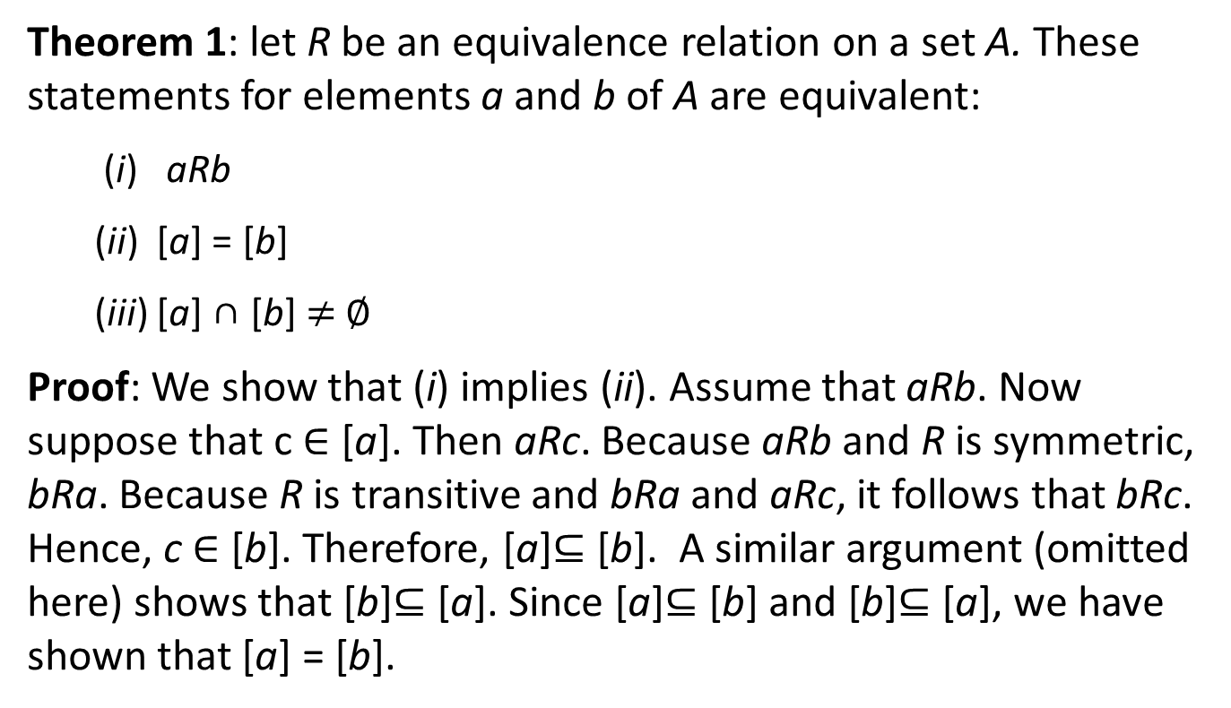
Equivalence Classes and Partitions
Theorem 1: let R be an equivalence relation on a set A. These statements for elements a and b of A are equivalent:
(i) aRb
(ii) [a] = [b]
(iii) [a] ∩ [b] $≠$ ∅
Proof: We show that (i) implies (ii). Assume that aRb. Now suppose that c ∈ [a]. Then aRc. Because aRb and R is symmetric, bRa. Because R is transitive and bRa and aRc, it follows that bRc. Hence, c ∈ [b]. Therefore, [a]⊆ [b]. A similar argument (omitted here) shows that [b]⊆ [a]. Since [a]⊆ [b] and [b]⊆ [a], we have shown that [a] = [b].
(see text for proof that (ii) implies (iii) and (iii) implies (i))

Slide 48
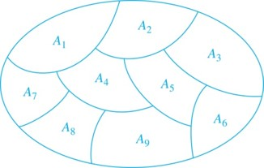
Partition of a Set
Definition: A partition of a set S is a collection of disjoint nonempty subsets of S that have S as their union. In other words, the collection of subsets A_{i}, where i ∈ I (where I is an index set), forms a partition of S if and only if
A_{i} ≠ ∅ for i ∈ I,
A_{i} ∩ A_{j} = ∅ when i ≠ j,
and
A Partition of a Set

Slide 49
An Equivalence Relation Partitions a Set 1
Let R be an equivalence relation on a set A. The union of all the equivalence classes of R is all of A, since an element a of A is in its own equivalence class [a]_{R}. In other words,
From Theorem 1, it follows that these equivalence classes are either equal or disjoint, so
when
Therefore, the equivalence classes form a partition of A, because they split A into disjoint subsets.

Slide 50
An Equivalence Relation Partitions a Set 2
Theorem 2: Let R be an equivalence relation on a set S. Then the equivalence classes of R form a partition of S. Conversely, given a partition {A_{i} | i ∈ I} of the set S, there is an equivalence relation R that has the sets A_{i}, i ∈ I, as its equivalence classes.
Proof: We have already shown the first part of the theorem.
For the second part, assume that {A_{i} | i ∈ I} is a partition of S. Let R be the relation on S consisting of the pairs (x, y) where x and y belong to the same subset A_{i} in the partition. We must show that R satisfies the properties of an equivalence relation.
Reflexivity: For every a ∈ S, (a,a) ∈ R, because a is in the same subset as itself.
Symmetry: If (a,b) ∈ R, then b and a are in the same subset of the partition, so (b,a) ∈ R.
Transitivity: If (a,b) ∈ R and (b,c) ∈ R, then a and b are in the same subset of the partition, as are b and c. Since the subsets are disjoint and b belongs to both, the two subsets of the partition must be identical. Therefore, (a,c) ∈ R since a and c belong to the same subset of the partition.

Slide 51
Partial Orderings
Section 9.6

Slide 52
Section Summary
Partial Orderings and Partially-ordered Sets
Lexicographic Orderings
Hasse Diagrams
Lattices (not currently in overheads)
Topological Sorting (not currently in overheads)

Slide 53
Partial Orderings 1
Definition 1: A relation R on a set S is called a partial ordering, or partial order, if it is reflexive, antisymmetric, and transitive. A set together with a partial ordering R is called a partially ordered set, or poset, and is denoted by (S, R). Members of S are called elements of the poset.

Slide 54
Partial Orderings 2
Example 1: Show that the “greater than or equal” relation (≥) is a partial ordering on the set of integers.
Reflexivity: a ≥ a for every integer a.
Antisymmetry: If a ≥ b and b ≥ a , then a = b.
Transitivity: If a ≥ b and b ≥ c , then a ≥ c.
These properties all follow from the order axioms for the integers. (See Appendix 1).

Slide 55
Partial Orderings 3
Example 2: Show that the divisibility relation (∣) is a partial ordering on the set of integers.
Reflexivity: a ∣ a for all integers a. (see Example 9 in Section 9.1)
Antisymmetry: If a and b are positive integers with a | b and b | a, then a = b. (see Example 12 in Section 9.1)
Transitivity: Suppose that a divides b and b divides c. Then there are positive integers k and l such that b = ak and c = bl. Hence, c = a(kl), so a divides c. Therefore, the relation is transitive.
(Z⁺, ∣) is a poset.

Slide 56
Partial Orderings 4
Example 3: Show that the inclusion relation (⊆) is a partial ordering on the power set of a set S.
Reflexivity: A ⊆ A whenever A is a subset of S.
Antisymmetry: If A and B are positive integers with A ⊆ B and B ⊆ A, then A = B.
Transitivity: If A ⊆ B and B ⊆ C, then A ⊆ C.
The properties all follow from the definition of set inclusion.

Slide 57
Comparability
Definition 2: The elements a and b of a poset (S,≼ ) are comparable if either a ≼ b or b ≼ a. When a and b are elements of S so that neither a ≼ b nor b ≼ a, then a and b are called incomparable.
The symbol ≼ is used to denote the relation in any poset.
Definition 3: If (S,≼ ) is a poset and every two elements of S are comparable, S is called a totally ordered or linearly ordered set, and ≼ is called a total order or a linear order. A totally ordered set is also called a chain.
Definition 4: (S,≼ ) is a well-ordered set if it is a poset such that ≼ is a total ordering and every nonempty subset of S has a least element.

Slide 58
Lexicographic Order
Definition: Given two posets (A₁,≼₁) and (A₂,≼₂), the lexicographic ordering on A₁ ⨉ A₂ is defined by specifying that (a₁, a₂) is less than (b₁,b₂), that is,
(a₁, a₂) ≺ (b₁,b₂),
either if a₁ ≺₁ b₁ or if a₁ = b₁ and a₂ ≺₂ b₂.
This definition can be easily extended to a lexicographic ordering on strings (see text).
Example: Consider strings of lowercase English letters. A lexicographic ordering can be defined using the ordering of the letters in the alphabet. This is the same ordering as that used in dictionaries.
discreet ≺ discrete, because these strings differ in the seventh position and e ≺ t.
discreet ≺ discreetness, because the first eight letters agree, but the second string is longer.

Slide 59
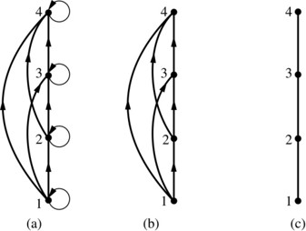
Hasse Diagrams
Definition: A Hasse diagram is a visual representation of a partial ordering that leaves out edges that must be present because of the reflexive and transitive properties.
A partial ordering is shown in (a) of the figure above. The loops due to the reflexive property are deleted in (b). The edges that must be present due to the transitive property are deleted in (c). The Hasse diagram for the partial ordering (a), is depicted in (c).
Jump to long description

Slide 60
Procedure for Constructing a Hasse Diagram
To represent a finite poset (S,≼) using a Hasse diagram, start with the directed graph of the relation:
Remove the loops (a, a) present at every vertex due to the reflexive property.
Remove all edges (x, y) for which there is an element z ∈ S such that x ≺ z and z ≺ y. These are the edges that must be present due to the transitive property.
Arrange each edge so that its initial vertex is below the terminal vertex. Remove all the arrows, because all edges point upwards toward their terminal vertex.

Slide 61
Appendix of Image Long Descriptions

Slide 62
Binary Relations - Appendix
In the left part of the picture, there are 5 points. Points 0, 1 , and 2 are placed one above the other forming a column. Points a and b are located aside forming another column. Arrows point from 0 to A, from 0 to B, from 1 to A, and from 2 to B. In the right part of the picture there is a table with two columns labeled as A and B and three rows labeled as 0,1 and 2. Some elements of the intersection of rows and columns are marked with a cross, the others are empty. Both elements of the first row are marked with a cross. Only the first element of the second line is marked with a cross, the second one is empty. The first element of the second line is empty, and the second one is marked with a cross.
Jump to the image

Slide 63
Matrices of Relations on Sets - Appendix
There is a square matrix, only the main diagonal is shown. All the elements of this diagonal are 1.
There are two square matrices A and B. In the matrix A, the elements that are symmetric with respect to the main diagonal are equal; in matrix B, these elements are not equal.
Jump to the image

Slide 64
Representing Relations Using Digraphs - Appendix
Points A, B, C, and D are vertices of the graph. Arrows point from A to B, from A to D, from B to D. From C to A, from C to B and from D to B. The arrow pointing from B to D does not coincide with the arrow pointing from D to B. There is a circle that starts and ends at vertex B. This circle is a loop.
Jump to the image

Slide 65
Examples of Digraphs Representing Relations - Appendix
Points 1, 2, 3, and 4 are vertices of the graph. Arrows point from 1 to 4, from 1 to 3, from 2 to 1, from 2 to 3, from 3 to 1, from 4 to 1, from 4 to 3. The arrow pointing from 1 to 3 does not coincide with the arrow pointing from 3 to 1. The arrow pointing from 1 to 4 does not coincide with the arrow pointing from 4 to 1. There are loops at vertices 2 and 3.
Jump to the image

Slide 66
Hasse Diagrams - Appendix
Case A. Points 1, 2, 3, and 4 located from the bottom to the top on the same line are vertices of the graph. Arrows point from 1 to 2, from 1 to 3, from 1 to 4, from 2 to 3, from 2 to 4, and from 3 to 4. There are loops at each vertex. Case B. The same graph is shown, but there are no loops at the vertices. Case C. The same graph is shown, but there are only edges connecting the vertices consequently present.
Jump to the image

